Slide 1
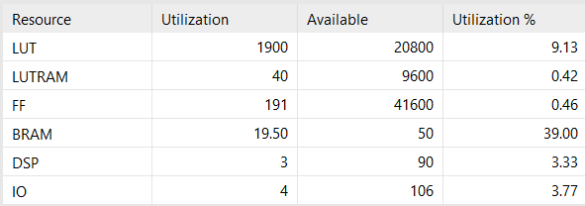
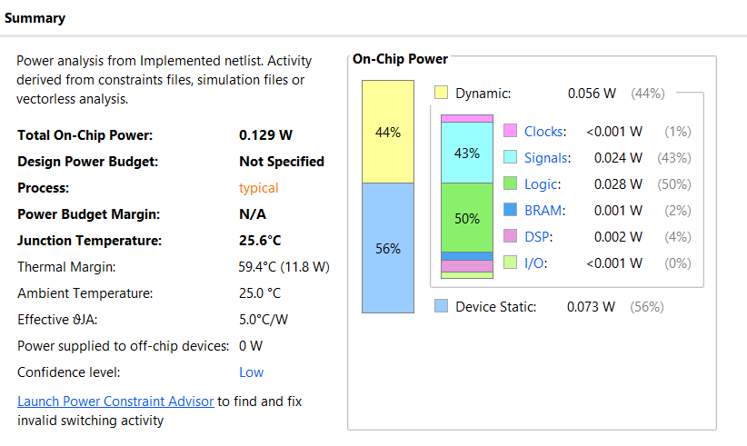
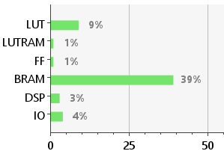
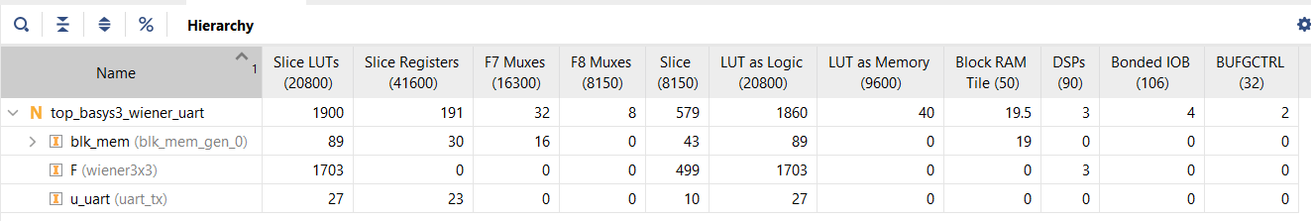
Problem Statement: Design a Weiner Filter for image processing. Use VGA and HDL or HLS for implementation.
(Due to unavailability of VGA cable, it was implemented using UART protocol).
GitHub link: https://github.com/ArismitaM/Weiner-Filter-using-FPGA
Power Summary
Resource Utilization

Slide 2
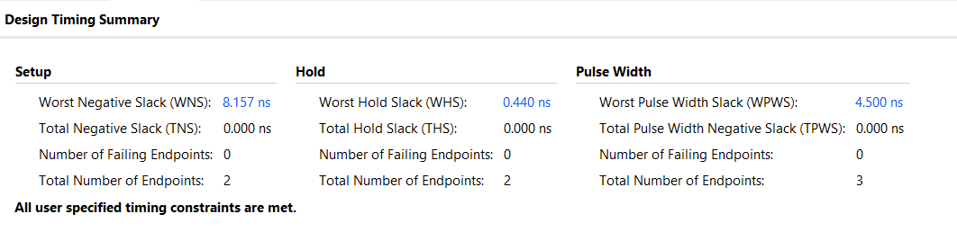
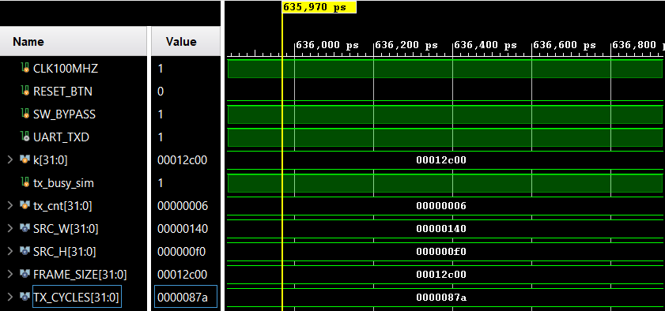
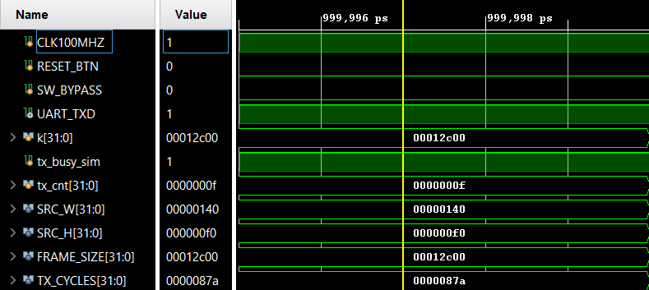
Timing Summary
Behavioural Simulation
SW Bypass 0 - Filtered Image
SW Bypass 1 - Raw Image

Slide 3
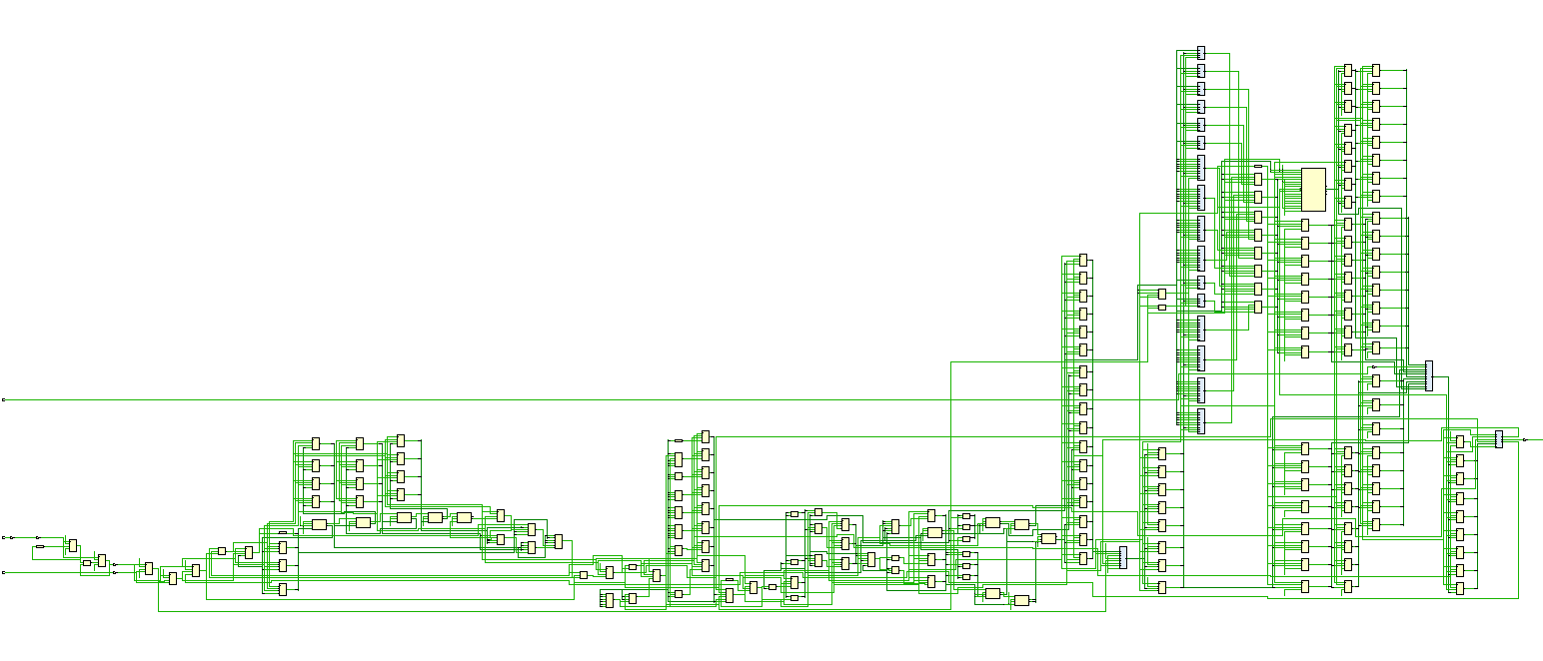
Schematic

